Slide 1



MY DIGITAL PORTFOLIO﻿
Name: S.Soundariya
Register no and NMID: 2426J0387, asbru4b2426j0387
Departmen:B.Sc(IT)
COLLAGE and UNIVERSITY,VNK collage,
Bharathiyar university

Slide 2

TOPIC
Web development
With HTML, CSS & JAVASCRIPT

Slide 3

AGENDA
Problem statement
Project overview
End users
Tools and Technology
Portfolio design and Layout
Features and Functionality
Results and Screeshots
Conclusion
Github Link

Slide 4

PROBLEM STATEMENT
1.
HTML gives structure to a webpage, CSS adds design and layout, and JavaScript makes it interactive. These three technologies work together to build responsive, user-friendly websites.
2.
3.

Slide 5

PROJECT OVERVIEW
HTML, CSS, and JavaScript are the building blocks of web development. HTML structures the content, CSS styles the appearance, and JavaScript adds interactivity to create engaging websites.

Slide 6

END USERS
End users are the people who visit and interact with a website. They benefit from HTML for clear content structure, CSS for attractive and responsive design, and javaScript for smooth, interactive features like forms, sliders, and dynamic updates. Together, these technologies ensure a better user experience.

Slide 7
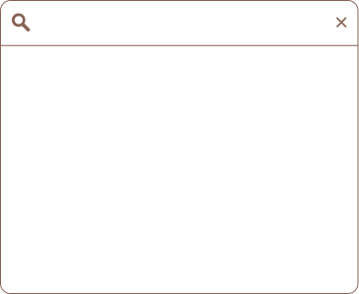
TOOLS AND
TECHNOLOGY
3.Developer Tools
Chrome Devtools
Firefox Developer Tools
Text Editors/IDEs
VS Code
Sublime ttext
Atom
2.Web browsers (for testing)
Google Chrom
Firfox
Edge
4.Version Control
Git
GitHub

Slide 8
PORTFOLIO DESIGN AND LAYOUT
A portfolio website uses HTML to organize content, CSS to style and layout the pages, and JavaScript to add interactivity. This combination helps create a clean, attractive, and user-friendly site to showcase your skills and projects.

Slide 9
FEATURES AND FUNCTIONALITY
HTML provides the structure of the website, CSS adds style and layout, and JavaScript adds functionality like interactive menus, form validation, and animations. Together, they create a dynamic and engaging user experience.

Slide 10

RESULTS AND SCREENSHOTS
Results show a fully functional website with clean layout and responsive design. Screenshots display the homepage, styled with CSS for colors and fonts, and interactive elements like buttons and forms powered by JavaScript. The site works smoothly across different devices and browsers.

Slide 11
CONCLUSION
The project successfully demonstrates how HTML, CSS, and JavaScript work together to create an interactive and visually appealing website. HTML provides the structure, CSS enhances the design, and JavaScript adds dynamic functionality. The final result is a responsive, user-friendly site that performs well across devices, meeting the project goals effectively.

Slide 12
GITHUB LINK
GitHub is a platform where developers can store and share their code projects. By creating a repository on GitHub, you can upload your HTML, CSS, and JavaScript files to keep them organized and accessible. It also helps with version control, allowing you to track changes and collaborate with others easily. Sharing the GitHub link lets others view or contribute to your project online.

Slide 13
THANK YOU.

